Slide 1
Investigating Cancer Cases in the UK
MATH 5747M Learning Skills through Case studies
Team members:
Yu Xie（201791780）
Kevin Timothy Muller
Shrichand Bhuria (201800797)
Zirui Huang(201750793)
Utkarsh Balooni (201792310) Sayan Banerjee (201802384)

Slide 2
Comparing cancer treatment methods
"Examining the effectiveness of SACT and RT treatment methods for prostate cancer.”

Slide 3
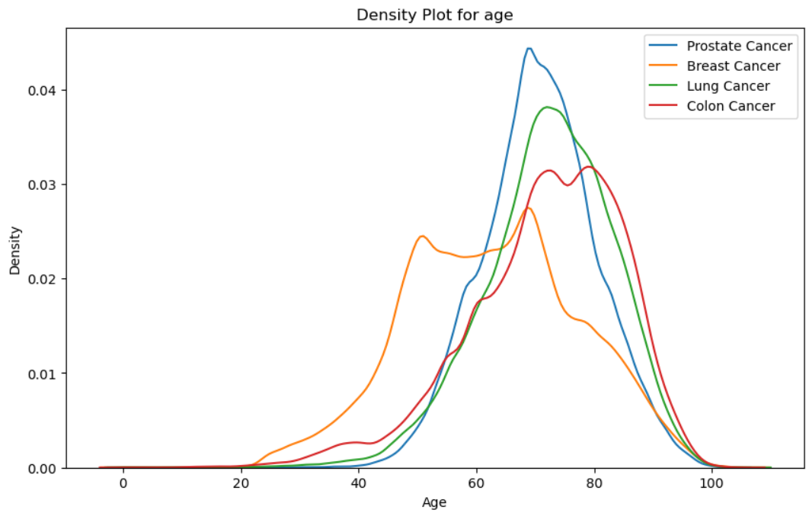
Density plot for age

Slide 4
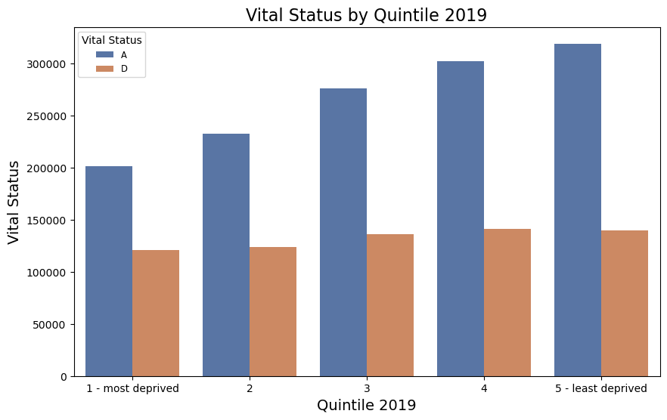
Vital Status of patients based on their deprivation level

Slide 5
Introduction:
Treatment of cancer with drugs involving chemotherapy and immunotherapy is called systemic anti-cancer treatment.
Radiation therapy (also called radiotherapy) is a cancer treatment that uses high doses of radiation to kill cancer cells and shrink tumors.
73.8% of prostate cancer patients receiving SACT were alive by the vital status collection date while the survival rate for those receiving RT was 76.56%.
Research Hypothesis - Compare the survival duration for different stages of prostate cancer patients receiving SACT and RT.

Slide 6
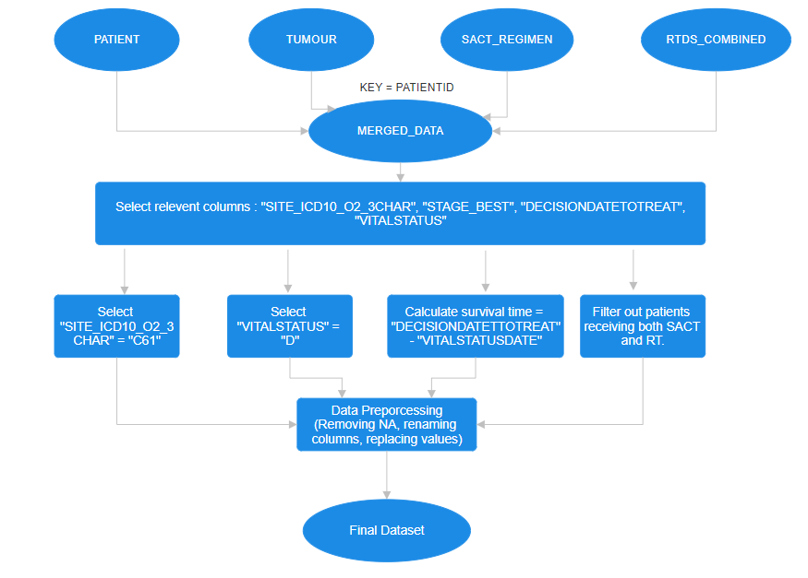
Data Preparation pipeline:

Slide 7
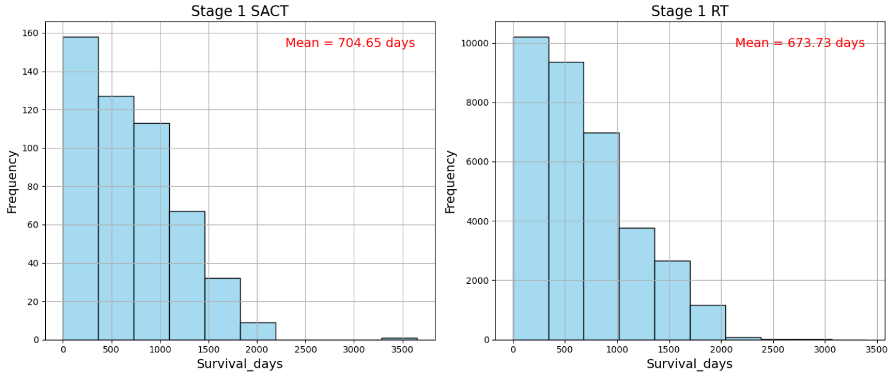
The following plots show the distribution of survival duration for different stages of prostate cancer for both the treatment methods

Slide 8
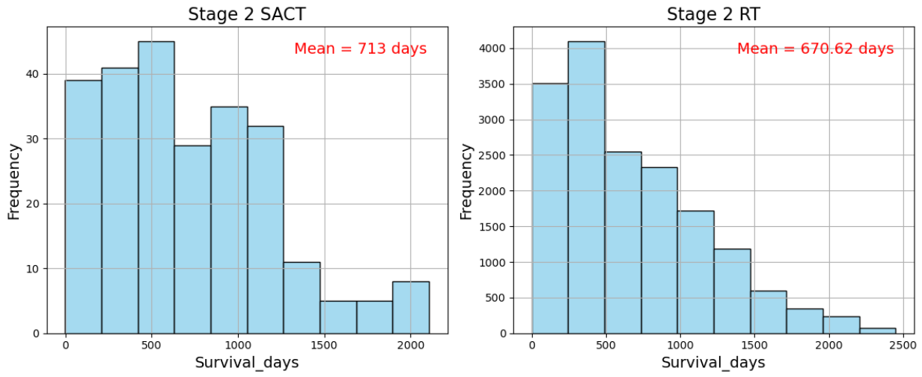
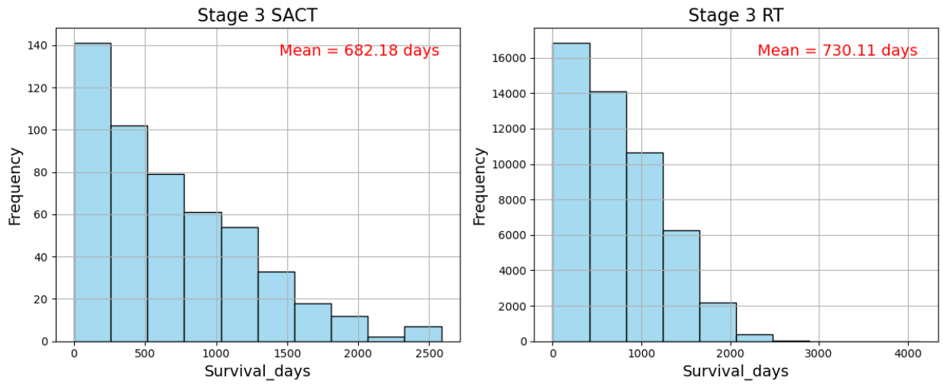

Slide 9
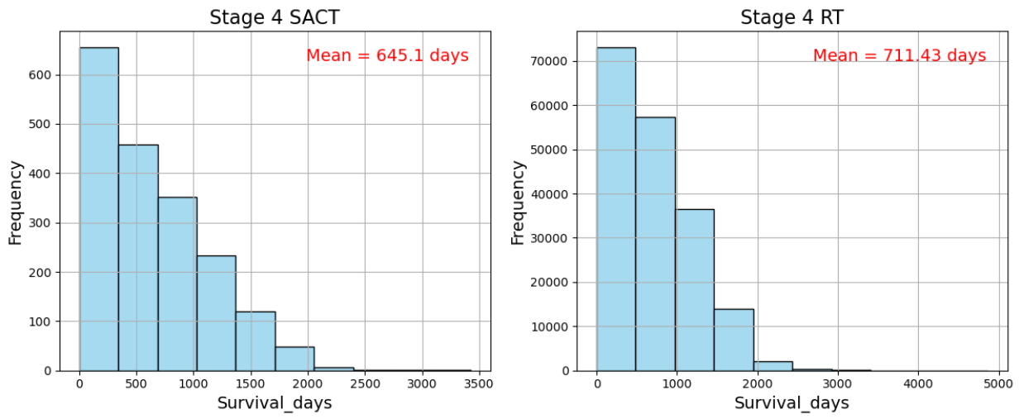
SACT has higher mean survival duration for Stage 1 and Stage 2 prostate cancer while RT works better for Stage 3 and Stage 4.
The distribution for survival duration seems to follow an exponential distribution.
Data recorded for SACT treatment of prostate cancer is lower.

Slide 10
Hypothesis Testing
To corroborate our results, we perform a 2 sample t-test on the data.
The following table summarizes the results of the t-test.
Stage | T-statistic | p-value | Significance at 5% level
Stage 1 | -1.419 | 0.156 | Not significant
Stage 2 | -1.321 | 0.186 | Not significant
Stage 3 | 2.146 | 0.031 | Significant
Stage 4 | 5.691 | 1.26e-08 | Significant

Slide 11
Validating the assumptions of the t-test:
Since the values come from individual patients, they are considered independent.
Data in each group is continuous and is obtained via random sampling.
Since n is large enough, normality of means can be safely assumed via the central limit theorem.
The variances of both the groups for all tests are comparable.
(≈ 1% difference)

Slide 12
Cancer Treatment Analysis
"Unveiling Treatment Efficacy in Cancer Survival: A Data-Driven Exploration"

Slide 13
Aims and Objectives
In the intricate landscape of patient recovery or demise, numerous factors come into play, including age, gender, genetic predispositions, and immune responses. However, among these variables, the pivotal determinant is the medication administered by healthcare providers to combat the disease directly.
Arguably the most influential factor, medication not only holds the potential to significantly impact patient outcomes but also exhibits considerable variability from one practitioner to another. In the realm of Systemic AntiCancer Therapy (SACT) alone, there exists a staggering array of 742 distinct treatments.
The aim is to hence unravel insights and discern trends regarding the
relationship between treatment methods and overall patient survival.

Slide 14
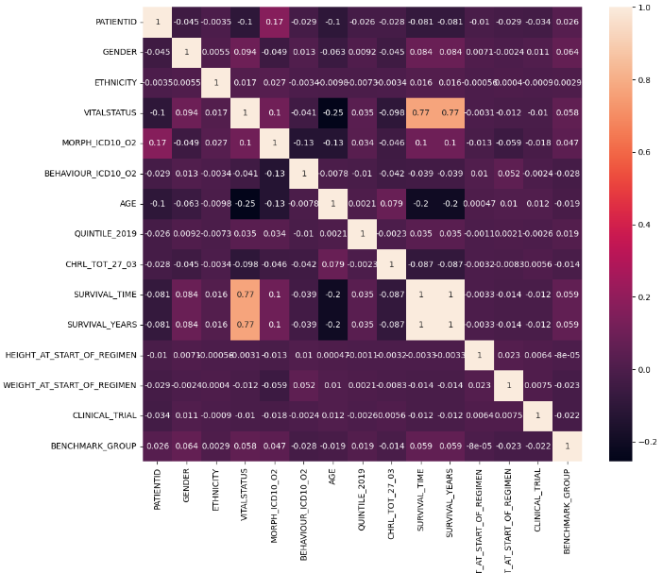
Preliminary Data Analysis
In order to analyze the cancer treatments and gain insights on cancer treatment trends, we make use of a combination of patient, tumor, sact_regimen and sact_outcome.
The correlation matrix shown on the right is aimed to justify a linear correlation between BENCHMARK_GROUP and VITALSTATUS but that is not the case here.

Slide 15
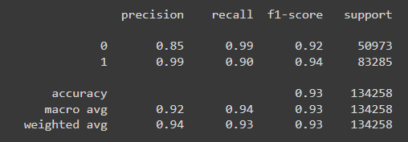
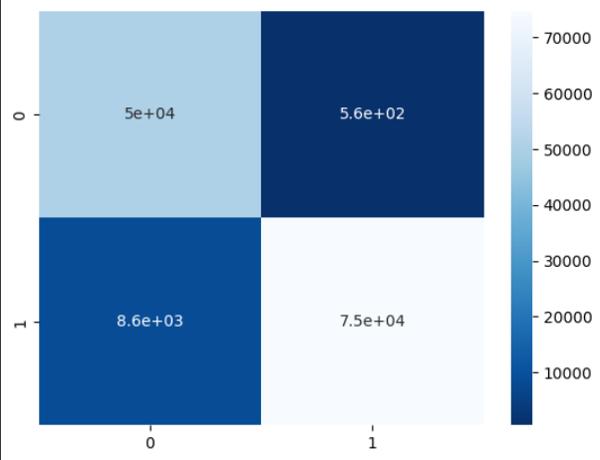
Modelling using RandomForestClassifier
With the help of the RandomForest Model, we can explore relationships between the explanatory variables (BENCHMARK_GROUP in specific) and the target variable VITALSTATUS.
A high accuracy and f1 score indicates a valid model which is sure to have a good understanding of the dataset.

Slide 16
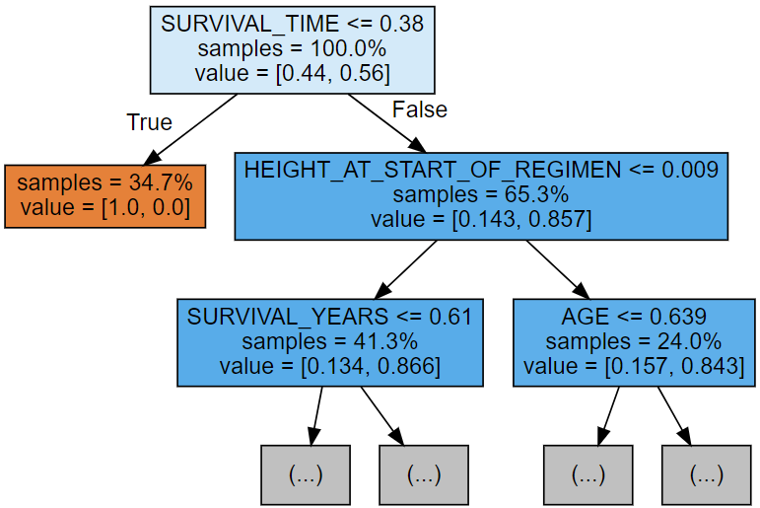
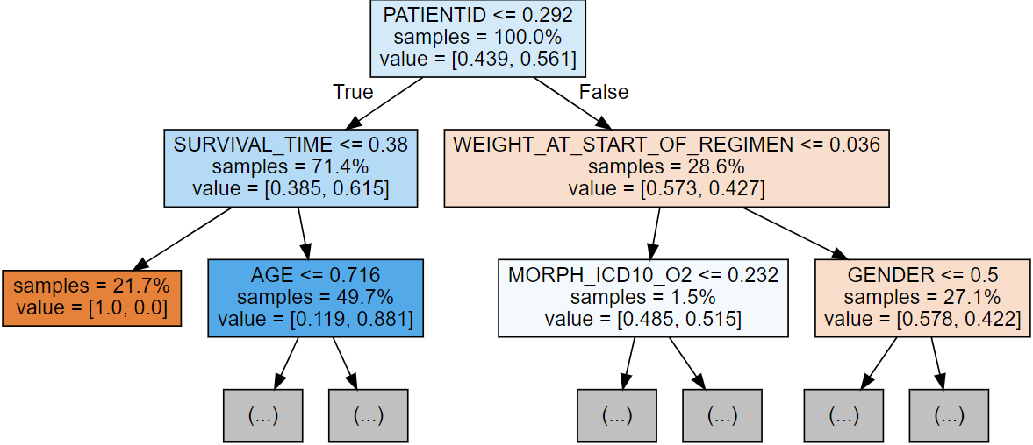
Analysis of Random Forests
The random forests given by the model are as follows :
Tree 1
Tree 2

Slide 17
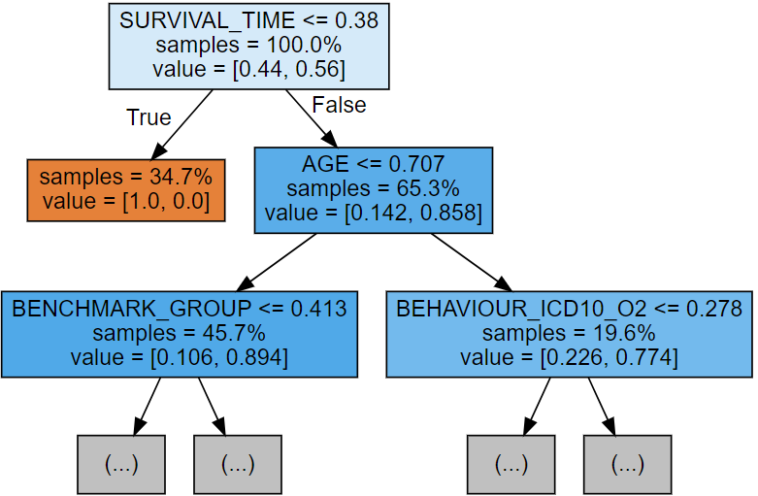
Analysis of Random Forests (Contd.)
In Tree 3, we see the inclusion of BENCHMARK_GROUP in the decision process. Not only is it present in the tree, but it also carries a significant weight in predicting the outcome of 45.7% of the inputs.
We infer that patients with a survival time greater than the 38th percentile, have an age below the 70th percentile, and are present in a treatment plan of BENCHMARK_GROUP below the 41st percentile are likely to survive.
Tree 3

Slide 18
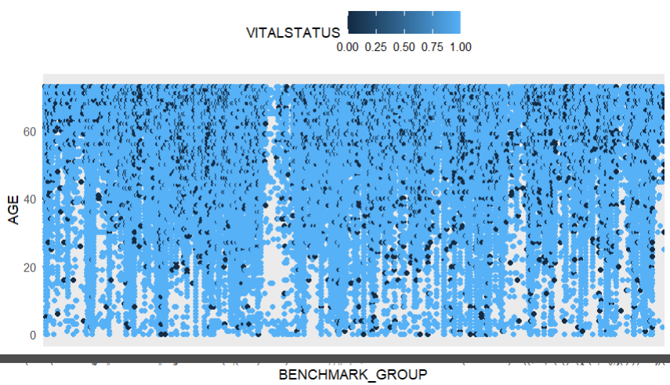
Plotting of Survival Trend
The graph plotted on the right is of patients with a survival time greater than the 38th percentile and who have an age below the 70th percentile, across all BENCHMARK_GROUPS.
From the plot, we observe that patients belonging to the BENCHMARK_GROUP below the 41st percentile are more likely to survive cancer; that is, have an increased survival rate.

Slide 19
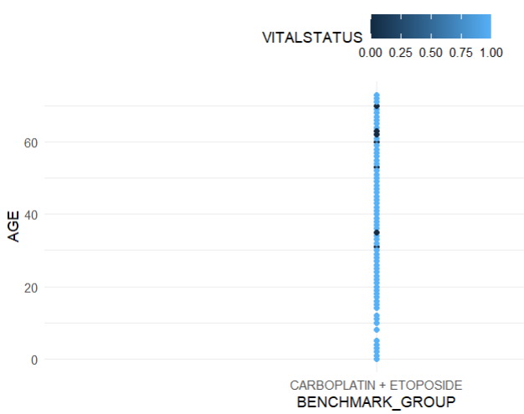
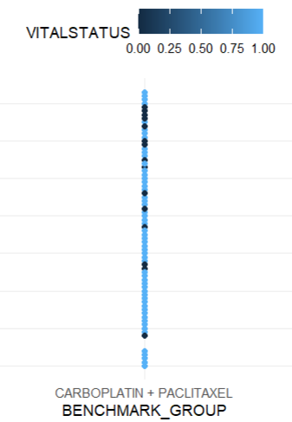
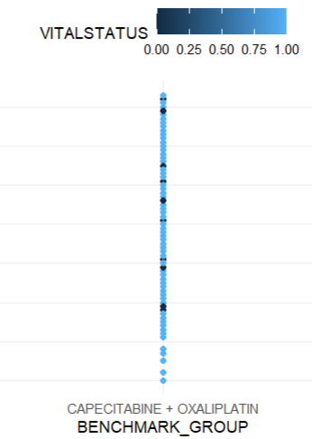
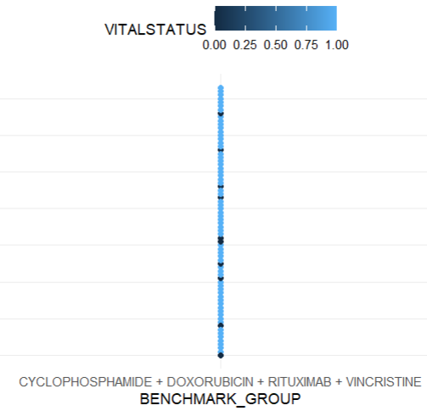
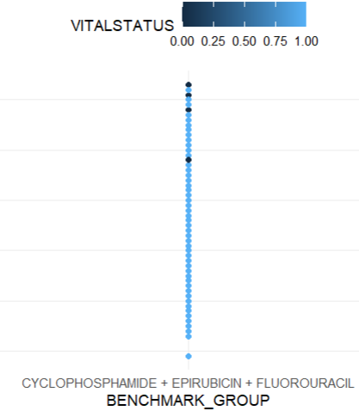
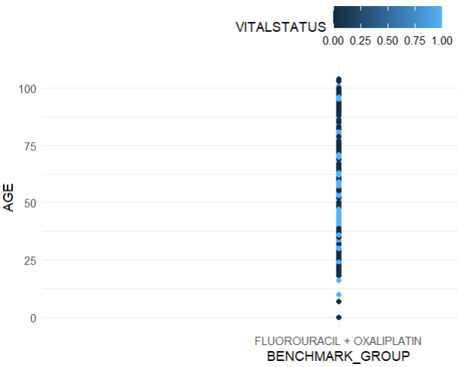
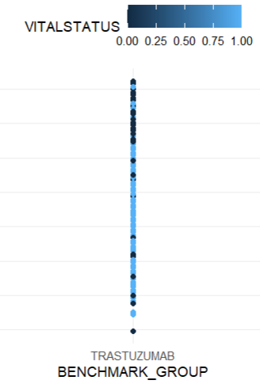
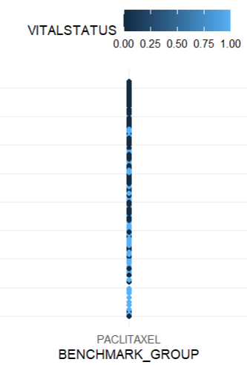
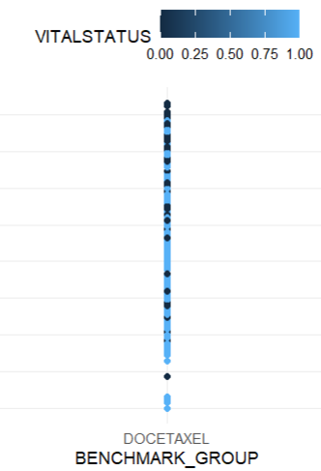
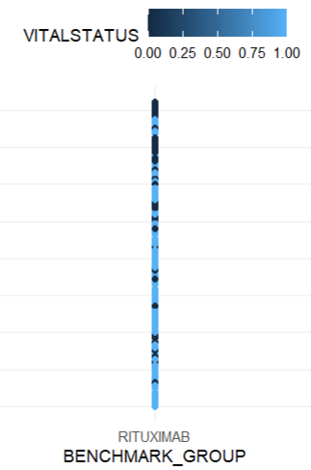
Model constraints vs Without model constraints
With :
Without :

Slide 20
Conclusions
In conclusion, we can say that with a SURVIVALTIME greater than 915.8 days, AGE of less than 73.53 years and under the treatment of a BENCHMARK_GROUP alphabetically before "CVD R", the patient has a probability of survival of upto 0.82.
Although extensive research is already conducted on drugs such as Carboplatin, Etoposide, Capecitabine etc. with effective cure rates lending to it’s high usage, there are no studies relating it to it’s even better benefits for patients of younger age.
There are more nodes which can be explored in the RandomForest decision trees which could potentially lead to even more insights.

Slide 21
Survival Analysis
Timely Treatment Initiation

Slide 22
Aim of Research
Evaluate Survival Outcomes Compare survival probabilities across different diagnosis-to-treatment times.
Identify Optimal Timing for Treatment Initiation Determine if there is a threshold beyond which treatment delays significantly compromise survival.
Explore Disparities in Survival Investigate whether certain patient groups are disproportionately affected by delays.

Slide 23
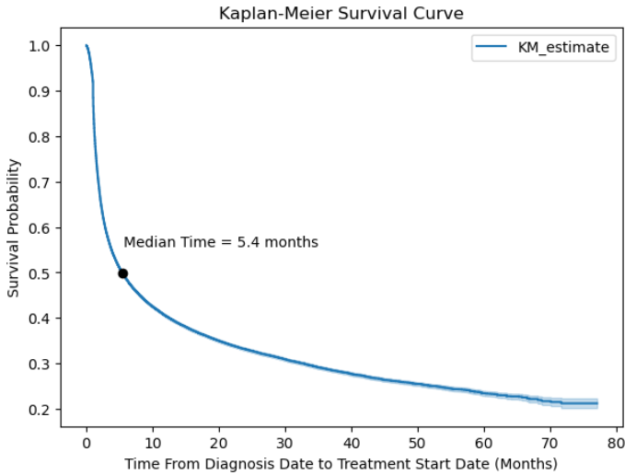
Kaplan-Meier Survival Analysis
The Kaplan-Meier survival curve helps us to visualise the survival probabilities for different diagnosis-to-treatment time values.
It calculates the survival probability at each time point as the product of the proportion of individuals surviving upto that time and and the conditional probability of surviving beyond that time, given that they have survived up to that point.

Slide 24
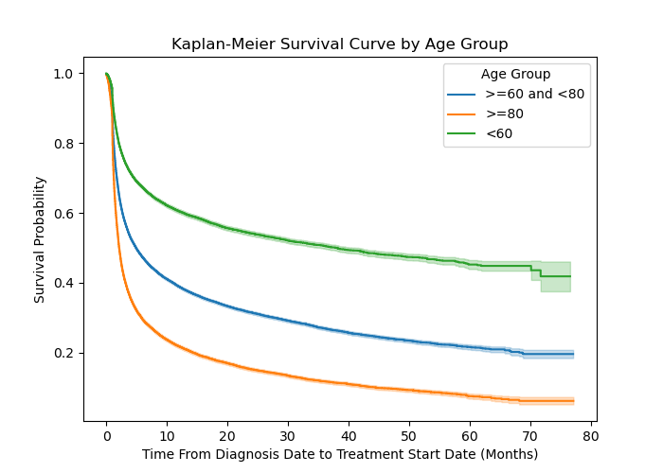
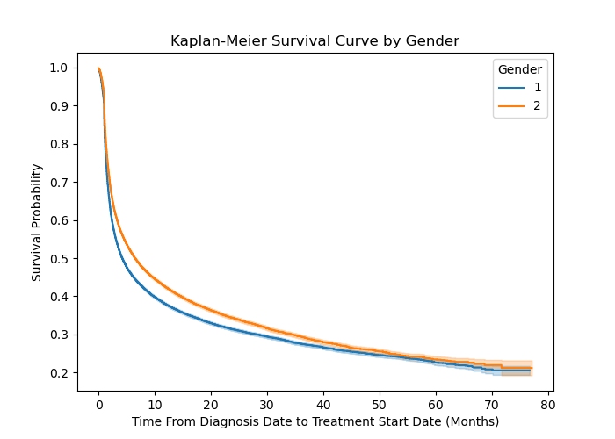
Survival Disparity based on Patient’s Demography
Age Group <60 : Median Time = 38.17
Age Group >=60 and <80 : Median Time = 4.97
Age Group >=80 : Median Time = 2.13
,
Gender 1: Median Time = 4.27
Gender 2: Median Time = 6.53

Slide 25
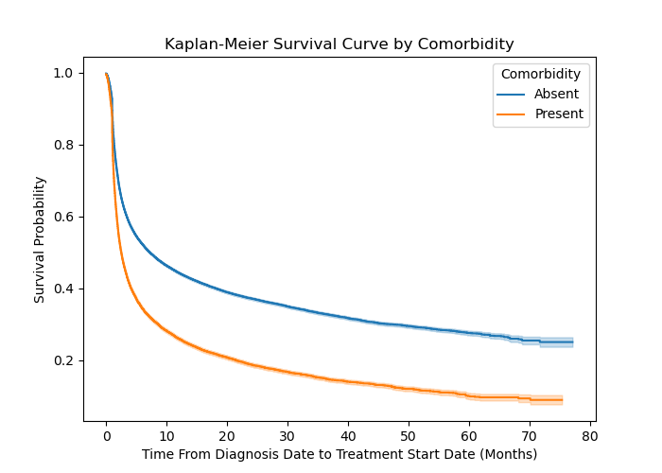
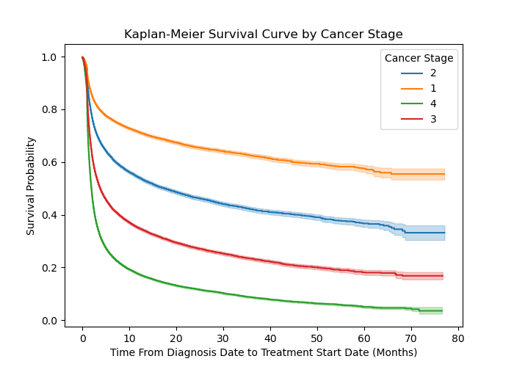
Survival Disparity based on Patient’s Health
Comorbidity Absent : Median Time = 7.27
Comorbidity Present : Median Time = 2.53
Cancer Stage 1 : Median Time > 80
Cancer Stage 2 : Median Time = 17.7
Cancer Stage 3 : Median Time = 3.83
Cancer Stage 4 : Median Time = 1.93

Slide 26
Conclusions
The median survival time for diagnosis to treatment is 5.4 months.
There is not enough data to accurately predict the median survival time of patients diagnosed with stage-1 cancer. All we can conclude is that they can start their treatment after 80 months from diagnosis without affecting their survival probability.
Comorbid patients who are above 80 years of age and is diagnosed with stage-4 cancer have very less if not 0% chance of surviving.
More survival curves can be created using different combinations of patient’s demography and health attributes.

Slide 27
The correlation between
Tumour Grade and Regimen in prostate tumours

Slide 28
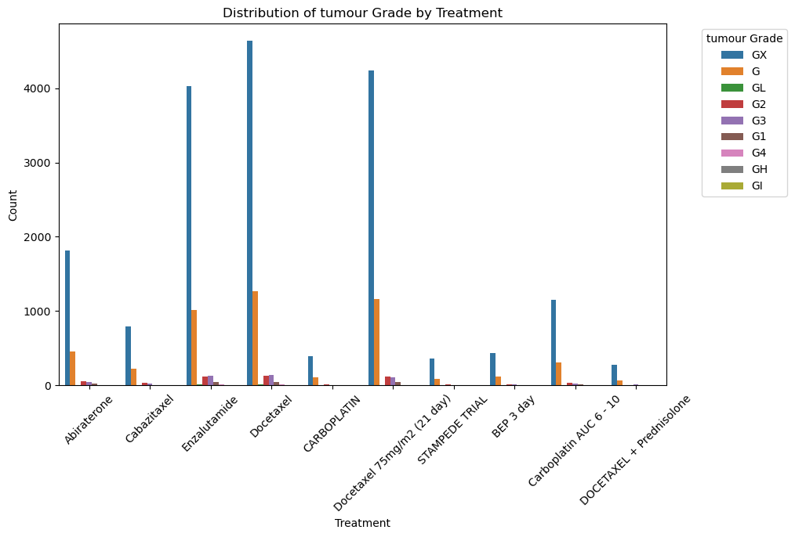
Tumour Grades
Data dictionary
0 Borderline malignant
1 Well differentiated
2 Moderately differentiated
3 Poorly differentiated
4 Undifferentiated
/non-resilient
H High
I Moderate
L Low
X X

Slide 29
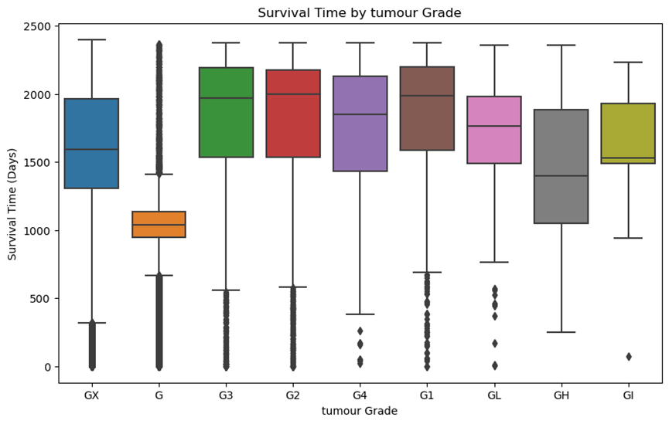
Survival time for different tumour grades
The median survival times for Grade G1 G2 G3 were all higher, at 1986 days 2024 and 1894 days, respectively.
The median survival time for Grade G was 1031 days, which was slightly lower than the median median for all data sets, suggesting that patients with Grade G generally had shorter survival times.
Challenge 3

Slide 30
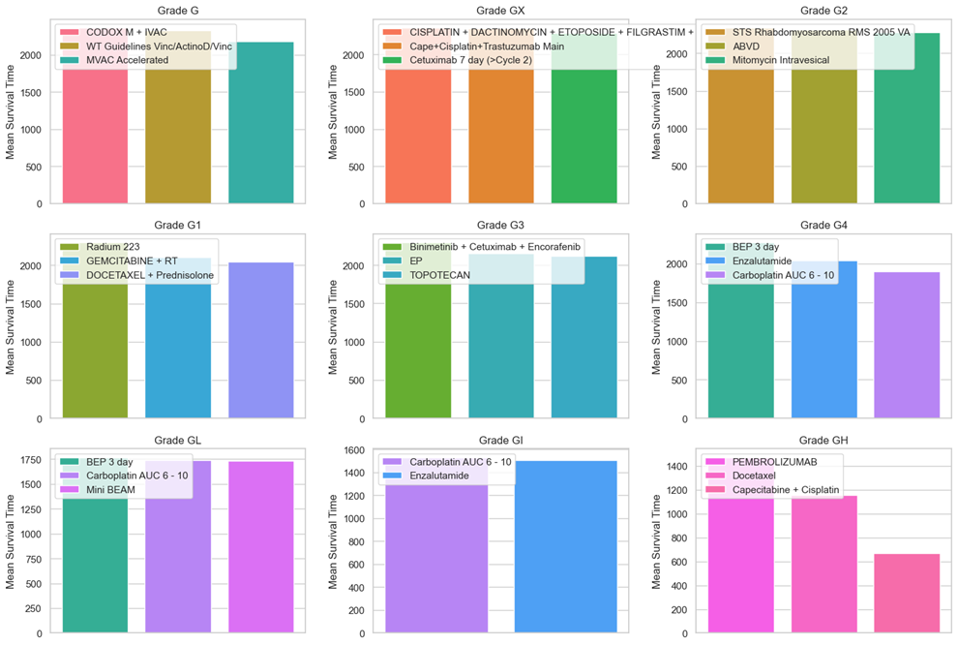
The most effective treatment for different tumour grades
Challenge 3

Slide 31
The most effective treatment for different tumour grades
Therefore, for different tumour types and grades, doctors will choose appropriate treatment plans taking into account the patient's physical condition and other factors.
Choice of treatment options:
For low-grade cancers, the treatment options may be relatively mild and a single chemotherapeutic drug or local treatment method may be chosen.
Impact of survival time:
The data show that different treatment regimens correspond to different survival times. For some high-grade or advanced cancers, more aggressive treatment regimens may be needed to prolong the patient's survival time.
Survival time is not directly related to the intensity of the treatment regimen in all cases.
Challenge 3

Slide 32
Predicting Treatment Outcome

Slide 33
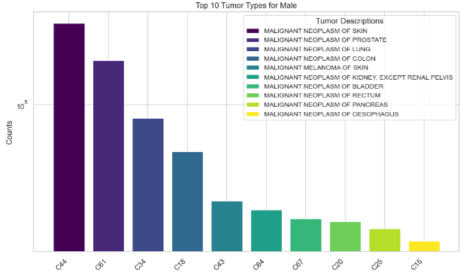
Top 10 cancer rates for men

Slide 34
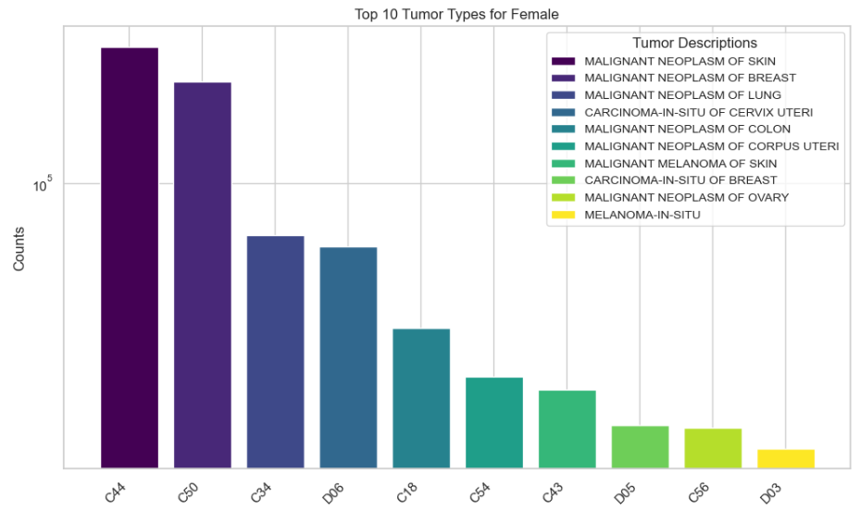
Top 10 cancer rates for women

Slide 35
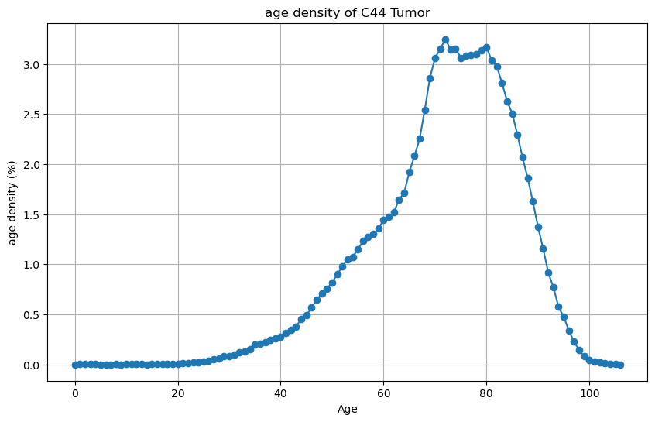
Density of skin cancer with age

Slide 36
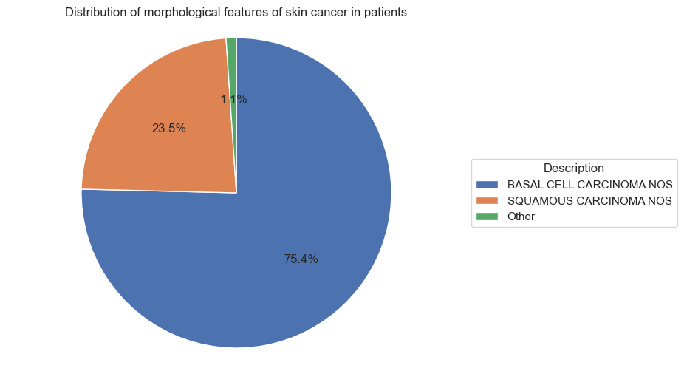
Distribution of morphological features of skin cancer in patients

Slide 37
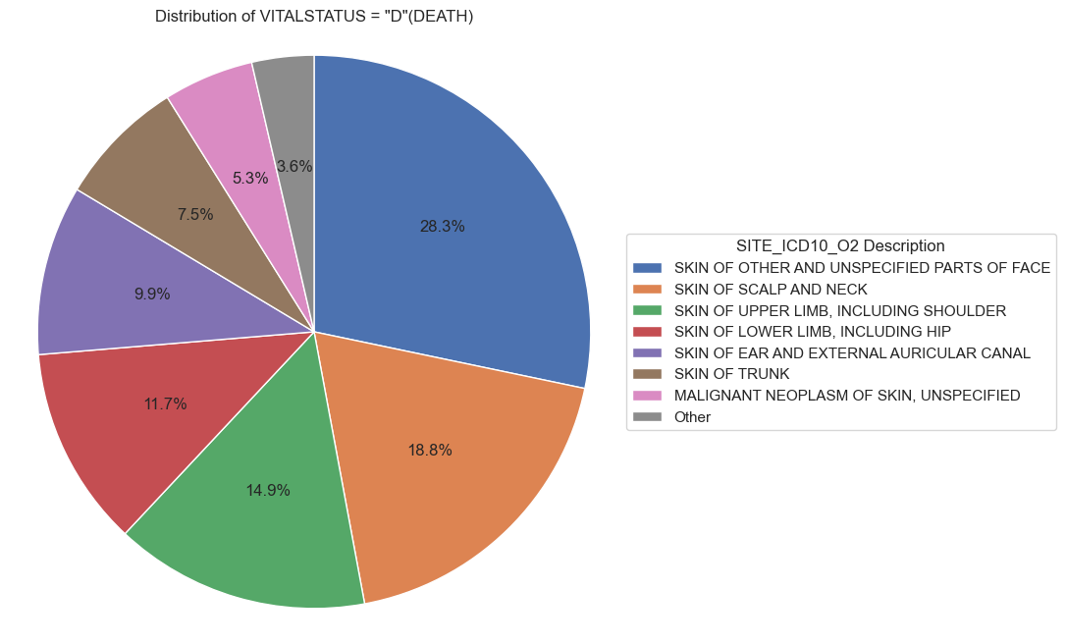
Distribution of patients (deaths) with skin cancer in different sites

Slide 38
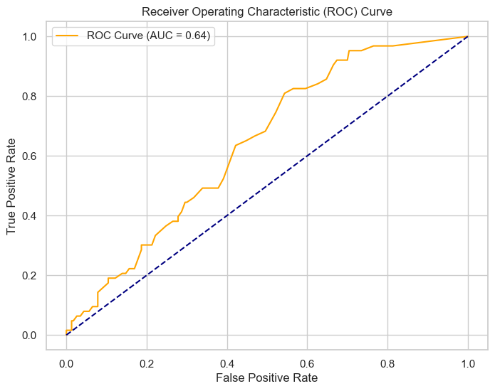
New features predict treatment outcome
Predicting new feature treatment effect by considering the variables 'GRADE', 'AGE', 'treatment duration', 'CYCLE_NUMBER'

Slide 39
Analyzing Demographic Influences on Frailty and Survival Time in UK Prostate Cancer Patients

Slide 40
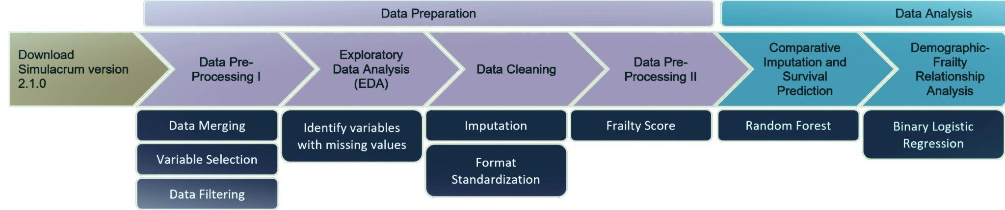
Flowchart of the data preparation and analysis process

Slide 41
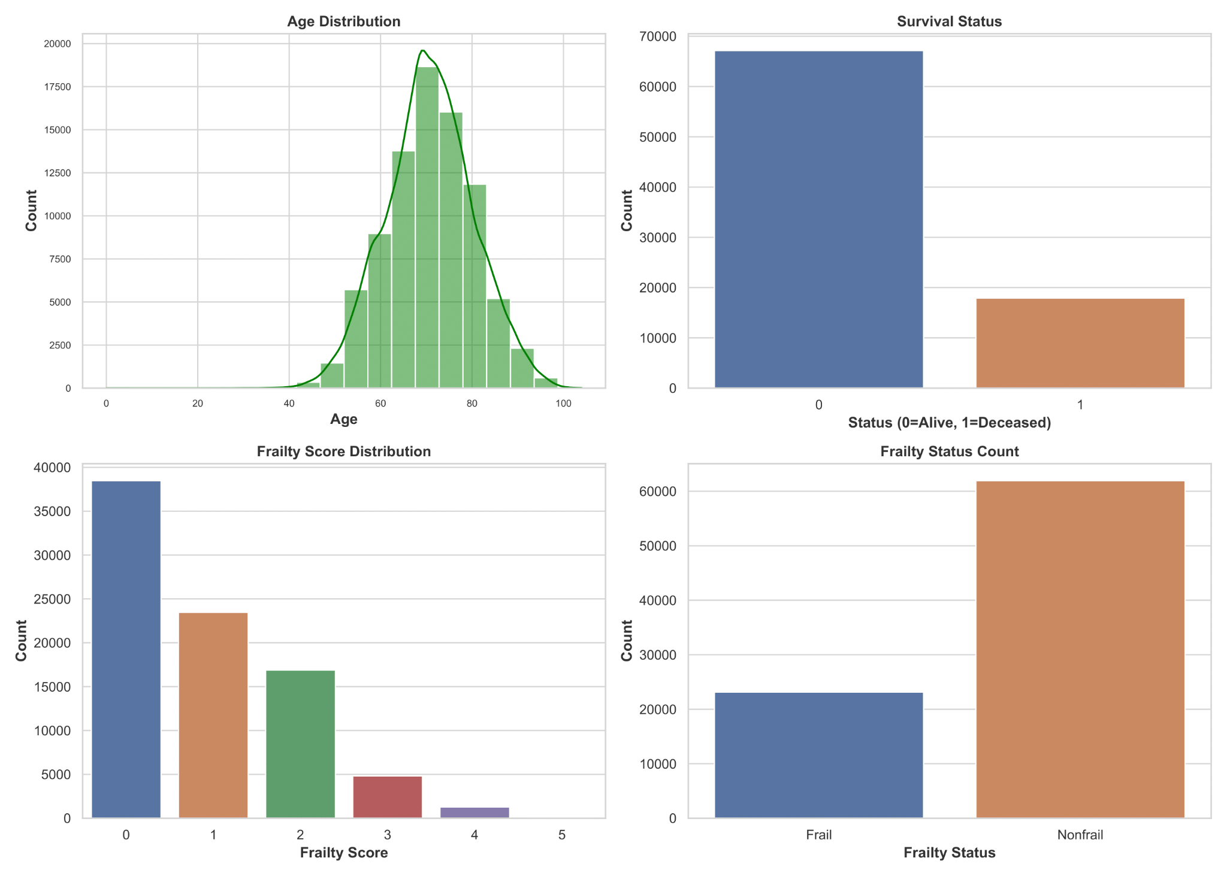
Exploratory Data Analysis
Age Distribution: Older patients are predominantly affected, with most in the 60–80 age range.
Frailty Score Distribution: Most patients have a low frailty score, emphasizing the need for tailored interventions.
Survival Status Count: Highlight the proportion of patients who are alive vs. deceased.

Slide 42
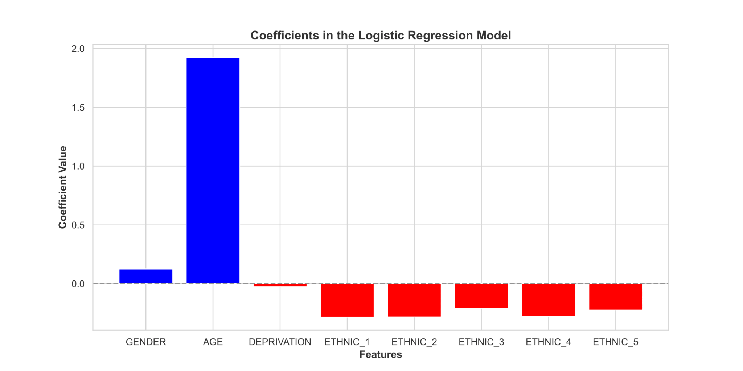
Modeling - Logistic Regression Analysis
Coefficients of the Logistic Regression Model: Age's strong positive impact on frailty, while ethnicity and deprivation seem to provide protective effects

Slide 43
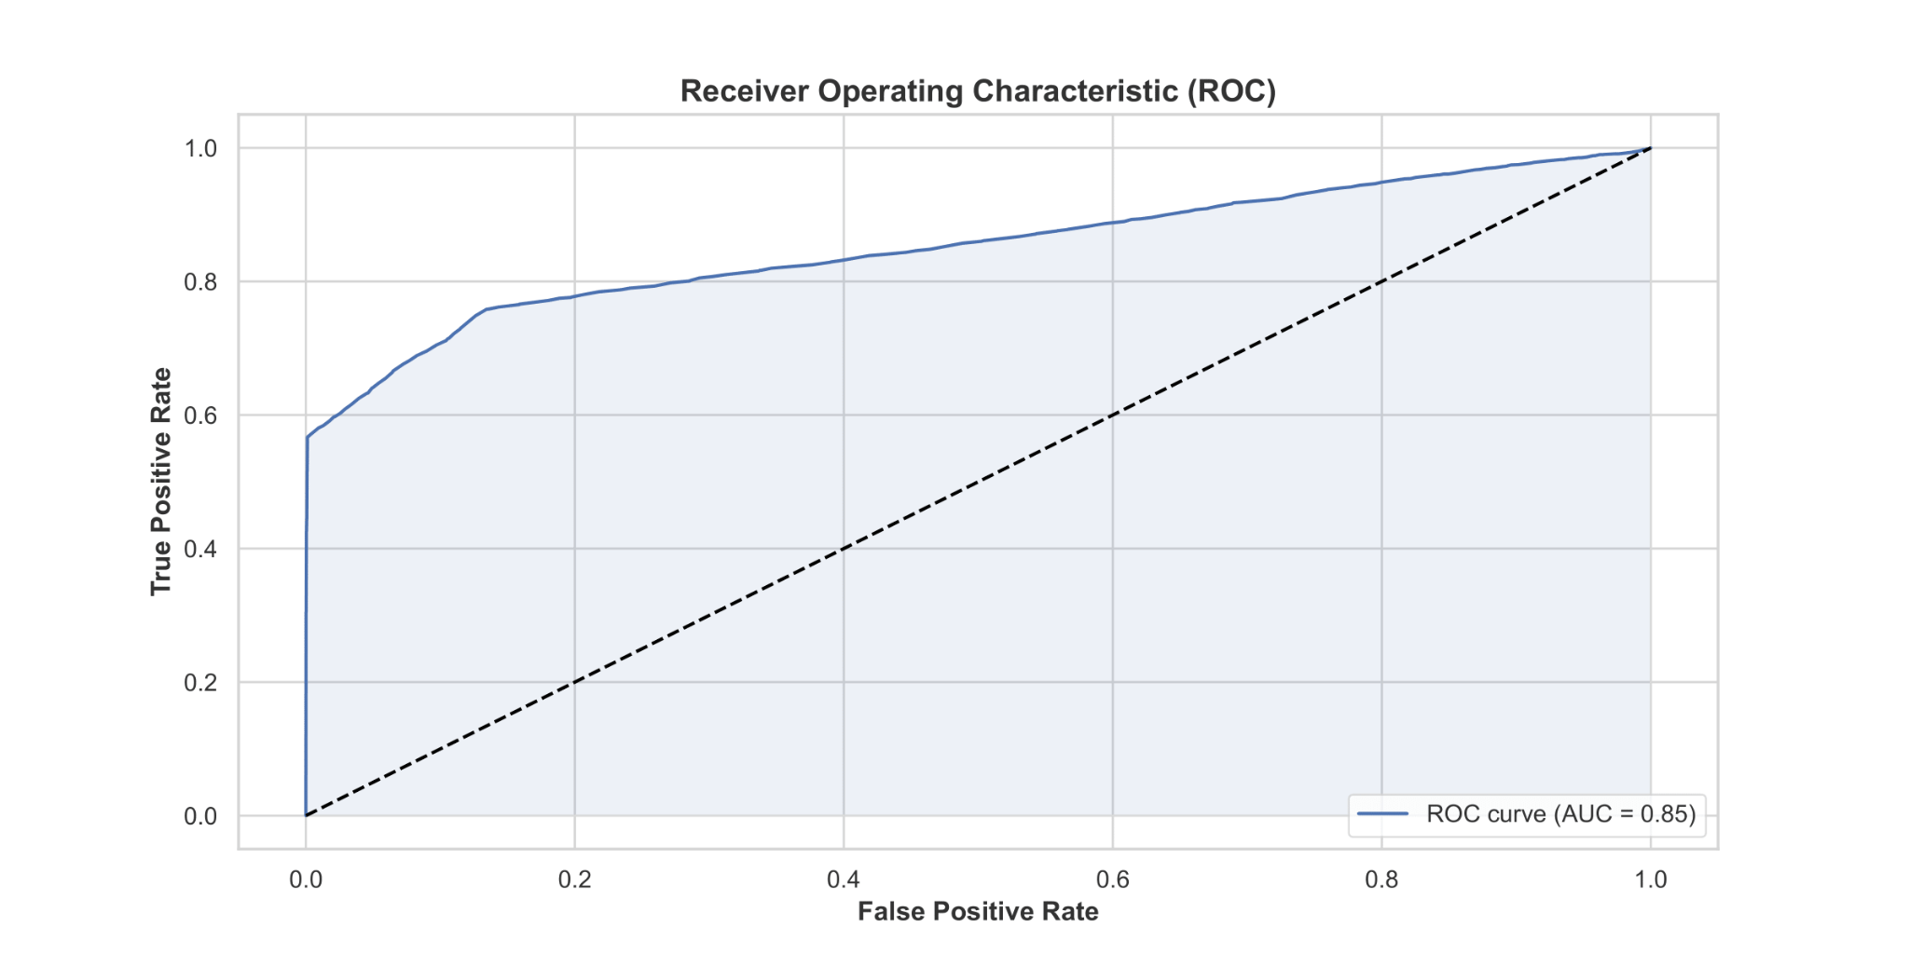
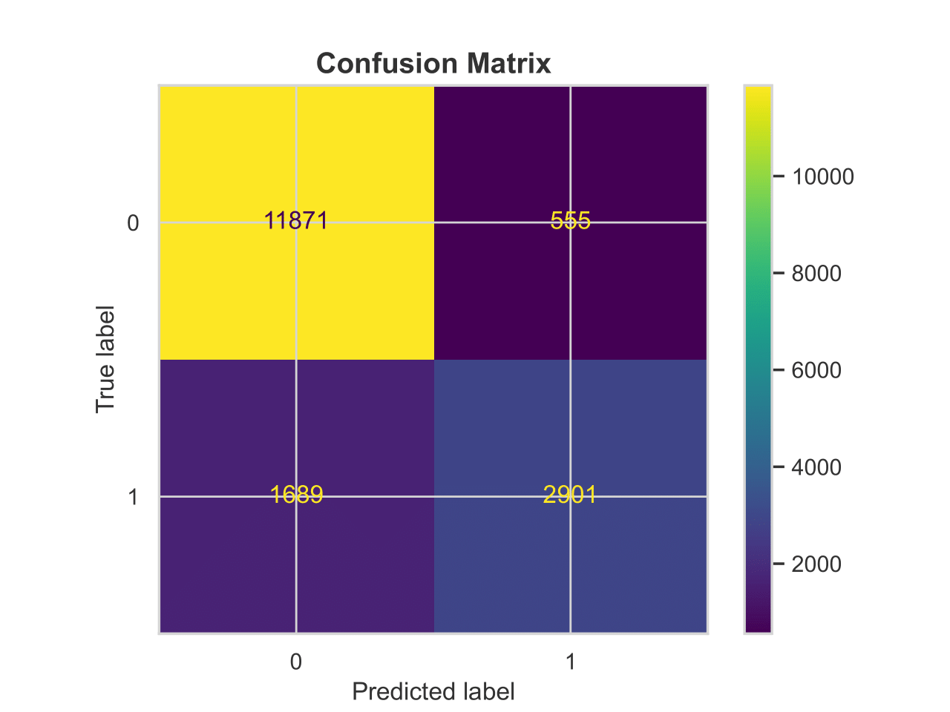
Predictive Performance of Logistic Regression
The model has an overall accuracy of 87%.
The ROC curve shows an AUC of 0.85, indicating a high level of accuracy in predicting frailty.
The confusion matrix reveals a high number of true positives and true negatives, suggesting that the model is highly reliable in classifying patients based on their frailty status.

Slide 44
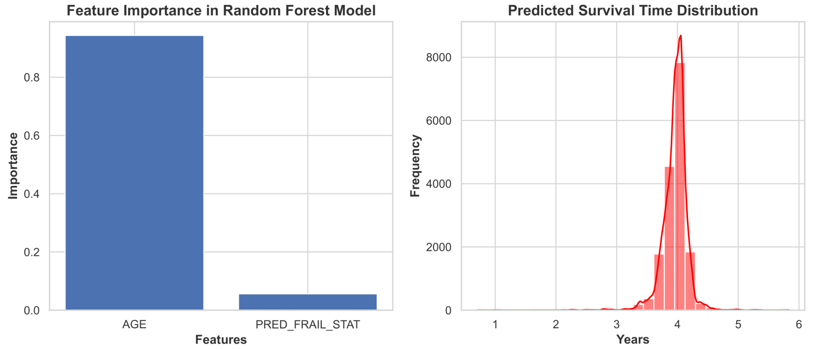
Random Forest Modeling
Feature Importance and Predicted Survival Time Distribution:
Feature Importance: Age is identified as the most significant feature influencing survival time.
Predicted Survival Time Distribution: The Random Forest model effectively predicts survival times for most patients.

Slide 45
Conclusion and Implications
Insights:
Age as a Primary Predictor: The study clearly identified age as the most significant factor affecting frailty and survival outcomes among prostate cancer patients.
Protective Factors: Logistic regression analysis revealed that deprivation and certain ethnic backgrounds may have protective effects against frailty.
Random Forest Model Findings: The random forest model emphasized the dominant role of age in predicting survival.
Implications for Clinical Practice:
Tailored Treatment: Utilize age and frailty scores to develop personalized, age-adjusted treatment plans.
Frailty as a Predictor: Frailty scores offer valuable insights into patient resilience, providing essential information for specialized care strategies.

